Slide 1
Asymptotic Analysis

Slide 2
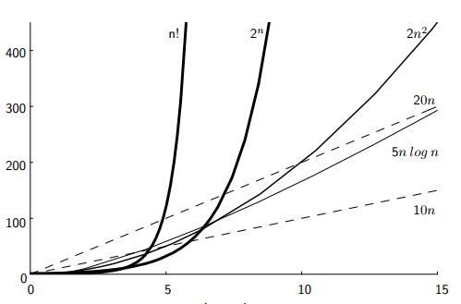
Asymptotic Analysis: Ignore the constants
Compare quadratic curve with he two linear curves
2n^2 crosses 10n at n =5
2n^2 crosses 20n at n =10
Changes to a constant factor in either equation only shift where the two curves cross, not whether the two curves cross.
So. we usually ignore the constants when we want an estimate of the growth rate for the running time.
simplifies the analysis
keeps us focused on the most important aspect: the growth rate.
This is called asymptotic algorithm analysis.

Slide 3
Upper bound, Lower Bound and…
There is another bound denoted by big-Theta notation (e.g., Θ(f(n))). We will talk about that later.
We may want to measure the upper bound for the growth of the algorithm’s running time
It indicates the upper or highest growth rate that the algorithm can have
Indicated by big-Oh notation (e.g., O(f(n)).
It states a claim about the greatest amount of some resource that is required by an algorithm for some class of inputs of size n
Could be for worst case/average case or best case inputs
We may want to measure the lower bound for the growth of the algorithm’s running time
Indicated by big-Omega or just Omega notation (e.g., Ω(f(n)).
It states a claim about the least amount of some resource that is required by an algorithm for some class of inputs of size n
Could be for worst case/average case or best case inputs

Slide 4
Upper bound- bog-Oh notation
If the upper bound for an algorithm’s growth rate (for, say, the worst case) is f(n) we say, this algorithm is
“in the set O(f(n)) in the worst case”
“in O(f(n))in the worst case”)
For example, if n^2 grows as fast as T(n) (the running time of our algorithm) for the worst-case input, we would say:
the algorithm is “in O(n^2) in the worst case”.

Slide 5
Big-oh
Definition: For T(n) a non-negatively valued function, T(n) is in the set O(f(n)) if there exist two positive constants c and n₀ such that T(n) <= cf(n) for all n > n₀.
Example Use: We say, the algorithm is in O(n²) in [best, average, worst] case.
Meaning: For all data sets big enough (i.e., n>n₀), the algorithm always executes in less than cf(n) steps in [best, average, worst] case.
Notes:
Must pick one of [best, average, worst] to complete the statement. Big-oh notation applies to some set of bounds.

Slide 6

Big-oh Notation (cont)
Big-oh notation indicates an upper bound.
Example: If T(n) = 3n² then T(n) is in O(n²).
Look for the tightest (i.e., lowest) upper bound:
If T(n) = 3n², we can also say that T(n) is in O(n³)
But we will always say that T(n) is in O(n²).
Notes:
It provides more information in this example to say O(n²) than O(n³).

Slide 7
Big-Oh Examples
Example 1: [Sequential Search] Finding value X in an array (average cost).
Then T(n) = c_{s}n/2.
For all values of n > 1, c_{s}n/2 <= c_{s}n.
Therefore, the definition is satisfied for:
f(n)=n,
n₀ = 1, and
c = c_{s}.
Hence, T(n) is in O(n).
For T(n) a non-negatively valued function, T(n) is in the set O(f(n)) if there exist two positive constants c and n₀ such that T(n) <= cf(n) for all n > n₀.
Notes:
We are doing average case.
c_{s} is a constant. The actual value is irrelevant.

Slide 8
Big-Oh Examples (2)
Example 2: Suppose T(n) = c₁n² + c₂n, where c₁ and c₂ are positive.
c₁n² + c₂n <= c₁n² + c₂n² <= (c₁ + c₂)n² for all n > 1.
Then T(n) <= cn² whenever n > n₀, for c = c₁ + c₂ and n₀ = 1.
Therefore, T(n) is in O(n²) by definition.
Example 3: T(n) = c. Then T(n) is in O(1).
For T(n) a non-negatively valued function, T(n) is in the set O(f(n)) if there exist two positive constants c and n₀ such that T(n) <= cf(n) for all n > n₀.

Slide 9
Big-Oh Examples (2)
Example 3: Assigning the value from the first position of an array to a variable takes constant time regardless of the size of the array.
Thus, T(n) = c (for the best, worst, and average cases).
We could say in this case that T(n) is in O(c).
However, it is traditional to say that an algorithm whose running time has a constant upper bound is in O(1).
For T(n) a non-negatively valued function, T(n) is in the set O(f(n)) if there exist two positive constants c and n₀ such that T(n) <= cf(n) for all n > n₀.

Slide 10
Big-Omega
Definition: For T(n) a non-negatively valued function, T(n) is in the set Ω(g(n)) if there exist two positive constants c and n₀ such that T(n) >= cg(n) for all n > n₀.
Meaning: For all data sets big enough (i.e., n > n₀), the algorithm always requires more than cg(n) steps.
Lower bound.

Slide 11
Big-Omega Example
For T(n) a non-negatively valued function, T(n) is in the set Ω(g(n)) if there exist two positive constants c and n₀ such that T(n) >= cg(n) for all n > n₀.
T(n) = c₁n² + c₂n.
c₁n² + c₂n >= c₁n² for all n > 1.
T(n) >= cn² for c = c₁ and n₀ = 1.
Therefore, T(n) is in Ω(n²) by the definition.
Look for the tightest (i.e., greatest) lower bound:
If T(n) = 3n², we can also say that T(n) is in Ω(n)
But we will always say that T(n) is in Ω(n²).

Slide 12
Big-Omega Examples
For T(n) a non-negatively valued function, T(n) is in the set Ω(g(n)) if there exist two positive constants c and n₀ such that T(n) >= cg(n) for all n > n₀.
[Sequential Search] Finding value X in an array (average cost).
Then T(n) = c_{s}n/2.
For all values of n > 1, c_{s}n/2 >= cn, where c <= c_{s}/2
Therefore, the definition is satisfied for:
f(n)=n,
n₀ = 1, and
c = c_{s}/2.
Hence, T(n) is in Ω(n).
Notes:
We are doing average case.
c_{s} is a constant. The actual value is irrelevant.

Slide 13
Theta Notation
From previous analysis:
For sequential search, we have
T(n) is in O(n)
&
T(n) is in Ω(n).
So, T(n) is in Θ(n).
When big-Oh and Ω coincide, we indicate this by using Θ (big-Theta) notation.
Definition: An algorithm is said to be in Θ(h(n)) if it is in O(h(n)) and it is in Ω(h(n)).
Example 1: [Sequential Search] Finding value X in an array (average cost).
Then T(n) = c_{s}n/2.
For all values of n > 1, c_{s}n/2 <= c_{s}n.
Hence, T(n) is in O(n).
[Sequential Search] Finding value X in an array (average cost).
Then T(n) = c_{s}n/2.
For all values of n > 1, c_{s}n/2 >= cn, where c <= c_{s}/2
Hence, T(n) is in Ω(n).
Notes:
For polynomial equations on T(n), we always have Θ. There is no uncertainty, since once we have the equation, we have a “complete” analysis.

Slide 14
Simplifying Rules
If f(n) is in O(g(n)) and g(n) is in O(h(n)), then f(n) is in O(h(n)).
If f(n) is in O(kg(n)) for some constant k > 0, then f(n) is in O(g(n)).
If f₁(n) is in O(g₁(n)) and f₂(n) is in O(g₂(n)), then (f₁ + f₂)(n) is in O(max(g₁(n), g₂(n))).
If f₁(n) is in O(g₁(n)) and f₂(n) is in O(g₂(n)) then f₁(n)f₂(n) is in O(g₁(n)g₂(n)).
you can ignore any multiplicative constants
you can ignore lower order terms
If T(n) = 3n^4 + 5n^2, then T(n) is in O(n^4).
The n^2 term contributes relatively little to the total cost for large n.
Similar or identical relation exists for big Omega and big Theta.
Notes:
2. Ignore constants.
3. Drop low order terms.
4. Useful for analyzing loops.

Slide 15
Time Complexity Examples (1)
Example 3.9: a = b;
This assignment takes constant time, so it is Θ(1).
Example 3.10:
sum = 0;
for (i=1; i<=n; i++)
sum += n;
Θ(1)
Θ(1)
Repeat n times
Θ(n)
Θ(1)
Θ(n)
Notes:
Asymptotic analysis is defined for equations. We need to convert programs to equations to analyze them.
The traditional notation is Θ(1), not Θ(c).
Θ(n) even though the value of sum is n².

Slide 16

Time Complexity Examples (2)
Example 3.11:
sum = 0;
for (j=1; j<=n; j++)
for (i=1; i<=j; i++)
sum++;
for (k=0; k<n; k++)
A[k] = k;
Θ(1)
Θ(1)
Repeat n times
Θ(1)
Θ(n)
Notes:
First statement is Θ(1). Double for loop is Σi = Θ(n²). Final for loop is Θ(n). Result: Θ(n²).

Slide 17
Time Complexity Examples (2)
1
Outer loop (1) Executes n times
for (j=1; j<=n; j++)
for (i=1; i<=j; i++)
sum++;
2
Inner loop (2) Executes j times depending on outer loop counter, j.
j changes (increases) at each iteration
Initially j is 1
Then j is 2
…
Finally, j is n
3
c
How many times Line 3 is executed?
1+2+ … + n = n(n+1)/2.
So, cost for Line 3 is c n(n+1)/2
= cn^2/2 + cn/2,
which is in Θ(n^2).
Notes:
First statement is Θ(1). Double for loop is Σi = Θ(n²). Final for loop is Θ(n). Result: Θ(n²).

Slide 18
Time Complexity Examples (2)
Example 3.11:
sum = 0;
for (j=1; j<=n; j++)
for (i=1; i<=j; i++)
sum++;
for (k=0; k<n; k++)
A[k] = k;
Θ(1)
Θ(1)
Θ(n^2)
Θ(n^2)
Θ(1)
Repeat n times
Θ(1)
Θ(n)
Notes:
First statement is Θ(1). Double for loop is Σi = Θ(n²). Final for loop is Θ(n). Result: Θ(n²).

Slide 19
Time Complexity Examples (3)
Example 3.12:
sum1 = 0;
for (i=1; i<=n; i++)
for (j=1; j<=n; j++)
sum1++;
sum2 = 0;
for (i=1; i<=n; i++)
for (j=1; j<=i; j++)
sum2++;
Θ(n^2)
Θ(n^2)
Θ(n^2)
Notes:
The only difference is j<=n vs. j<= i. First loop, sum is n². Second loop, sum is (n+1)(n)/2. Both are Θ(n²).

Slide 20
Time Complexity Examples (4)
Example 3.13:
sum1 = 0;
for (k=1; k<=n; k*=2)
for (j=1; j<=n; j++)
sum1++;
sum2 = 0;
for (k=1; k<=n; k*=2)
for (j=1; j<=k; j++)
sum2++;
Notes:
First loop is Σn for k = 1 to log n, or Θ(n log n).
Second loop is Σ2^{k} for k = 0 to log n - 1, or Θ(n).

Slide 21
Time Complexity Examples (4)
Example 3.13:
sum1 = 0;
for (k=1; k<=n; k*=2)
for (j=1; j<=n; j++)
sum1++;
sum2 = 0;
for (k=1; k<=n; k*=2)
for (j=1; j<=k; j++)
sum2++;
How many times this loop iterates?
Assume n is a power of 2.
Suppose we reach n at the mth iteration
n = 2^m
log_2 n = m.
Since we start at 1 = 2^0. total iteration is
log n + 1 [we will usually assume the base is 2],
which is in: Θ(log n)
Notes:
First loop is Σn for k = 1 to log n, or Θ(n log n).
Second loop is Σ2^{k} for k = 0 to log n - 1, or Θ(n).

Slide 22
Time Complexity Examples (4)
sum1 = 0;
for (k=1; k<=n; k*=2)
for (j=1; j<=n; j++)
sum1++;
sum2 = 0;
for (k=1; k<=n; k*=2)
for (j=1; j<=k; j++)
sum2++;
Θ(1)
Repeats log n + 1 times
Repeats n times
n(log n + 1) times
Θ(1)
Θ(1)
Notes:
First loop is Σn for k = 1 to log n, or Θ(n log n).
Second loop is Σ2^{k} for k = 0 to log n - 1, or Θ(n).

Slide 23
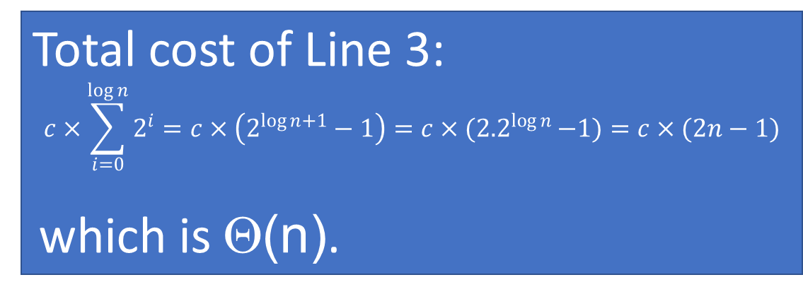
for (k=1; k<=n; k*=2)
for (j=1; j<=k; j++)
sum2++;
Inner loop (2)
Iteration 1: k = 1; executes 1 = 2^0 times
Iteration 2: k = 2; executes 2 = 2^1 times
Iteration 3: k = 4: executes 4 = 2^2 times
Iteration 4: k = 8: executes 8 = 2^3 times
…
Iteration log n + 1: k = n; executes n = 2^{log n} times
1
2
3
c
Total cost of Line 3:
$$c×\sum_{i=0}^{\log{n}}{2^{i}}=c×\left(2^{\log{n}+1}−1\right)=c×{(2.2}^{\log{n }}−1)=c×(2n−1)$$
which is Θ(n).

Slide 24
Time Complexity Examples (4)
sum1 = 0;
for (k=1; k<=n; k*=2)
for (j=1; j<=n; j++)
sum1++;
sum2 = 0;
for (k=1; k<=n; k*=2)
for (j=1; j<=k; j++)
sum2++;
Θ(1)
Repeats log n + 1 times
Θ(n log n)
Repeats n times
n(log n + 1) times
Θ(1)
Θ(n log n)
Repeats Θ(n) times
Θ(n)
Θ(1)
Notes:
First loop is Σn for k = 1 to log n, or Θ(n log n).
Second loop is Σ2^{k} for k = 0 to log n - 1, or Θ(n).

Slide 25
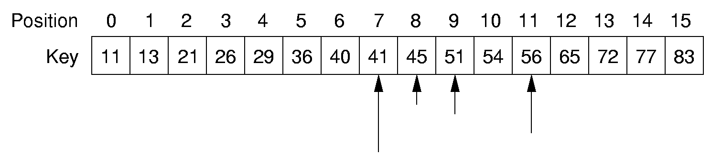
Binary Search
[Figure shows how binary search proceeds for searching the (index for the) value 45 in a sorted array of integers. Returns 8.]
[Same sequence of steps would follow had we searched for 44 (not in the array). Returns 16.]
How many elements are examined in worst case?

Slide 26
Binary Search
/** @return The position of an element in sorted array A with value k. If k is not in A,return A.length. */
static int binary(int[] A, int k) {
int l = -1; // Set l and r
int r = A.length; // beyond array bounds
while (l+1 != r) { // Stop when l, r meet
int i = (l+r)/2; // Check middle
if (k < A[i]) r = i; // In left half
if (k == A[i]) return i; // Found it
if (k > A[i]) l = i; // In right half
}
return A.length; // Search value not in A
}
At every iteration you find the mid point and focus on a segment that has size half the previous segment.
T(n) = T(n/2) + 1, for n>1
T(1) = 1
Closed form of this recurrence is:
T(n) = log n.
We will learn this sort of techniques later in this course…

Slide 27
Sequential Search of Binary Search?
Sequential Search Running time: Θ(n)
Binary Search Running Time: Θ(log n)
Any assumptions?
What happens if millions of searches are done?
What happens if new data needs to be inserted?

Slide 28
Other Control Statements
while loop: Analyze like a for loop.
if statement: Take greater complexity of then/else clauses.
switch statement: Take complexity of most expensive case.
Subroutine call: Complexity of the subroutine.
Notes:
if statement: The probabilities for the then/else clauses being executed must be independent of n.
switch statement: The probabilities of the various clauses being executed must be independent of n.

Slide 29
Problems
Problem: a task to be performed.
Best thought of as inputs and matching outputs.
Problem definition should include constraints on the resources that may be consumed by any acceptable solution.
Notes:
But NO constraints on HOW the problem is solved

Slide 30
Problems (cont)
Problems ⇔ mathematical functions
A function is a matching between inputs (the domain) and outputs (the range).
An input to a function may be single number, or a collection of information.
The values making up an input are called the parameters of the function.
A particular input must always result in the same output every time the function is computed.

Slide 31
Algorithms and Programs
Algorithm: a method or a process followed to solve a problem.
A recipe.
An algorithm takes the input to a problem (function) and transforms it to the output.
A mapping of input to output.
A problem can have many algorithms.

Slide 32
Analyzing Problems
Upper bound: Upper bound of best known algorithm.
Lower bound: Lower bound for every possible algorithm.
It is much easier to show that an algorithm (or program) is in Ω(f(n)) than it is to show that a problem is in Ω(f(n)).
For a problem to be in Ω(f(n)) means that every algorithm that solves the problem is in Ω(f(n)), even algorithms that we have not thought of yet.
Notes:
Analyzing problems is done a lot in a senior algorithms class.

Slide 33
Analyzing Problems: Example
May or may not be able to obtain matching upper and lower bounds.
Consider Sorting:
1. Cost of I/O: Ω(n).
2. Bubble or insertion sort: O(n²).
3. A better sort (Quicksort, Mergesort, Heapsort, etc.): O(n log n).
4. We prove later that sorting is in Ω(n log n).
Notes:
The examples so far have been easy in that exact equations always yield Θ. Thus, it is hard to distinguish Ω and O. This example should help to explain the difference. Bounds are used to describe our level of uncertainty about an algorithm.

Slide 34
Space/Time Tradeoff Principle
One can often reduce time if one is willing to sacrifice space, or vice versa.
Encoding or packing information
Boolean flags
Table lookup
Factorials
Disk-based Space/Time Tradeoff Principle: The smaller you make the disk storage requirements, the faster your program will run.

Slide 35
Multiple Parameters
Compute the rank ordering for all C pixel values in a picture of P pixels.
for (i=0; i<C; i++) // Initialize count
count[i] = 0;
for (i=0; i<P; i++) // Look at all pixels
count[value(i)]++; // Increment count
sort(count); // Sort pixel counts
If we use P as the measure, then time is Θ(P log P).
More accurate is Θ(P + C log C).
Notes:
Example picture size: 256 colors (8 bits), 1000 by 1000 pixels.

Slide 36
Space Complexity
Space complexity can also be analyzed with asymptotic complexity analysis.
Time: Algorithm
Space: Data Structure

Slide 37
Common Misunderstandings
“The best case for my algorithm is n=1 because that is the fastest.” WRONG!
Big-oh refers to a growth rate as n grows to ∞.
Best case is defined for the input of size n that is cheapest among all inputs of size n.
Notes:
We are doing average case.
c_{s} is a constant. The actual value is irrelevant.

Slide 38
Common Misunderstandings
Confusing worst case with upper bound.
Upper bound refers to a growth rate.
Worst case refers to the worst input from among the choices for possible inputs of a given size.

Slide 39
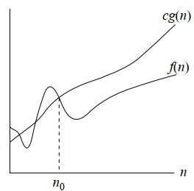
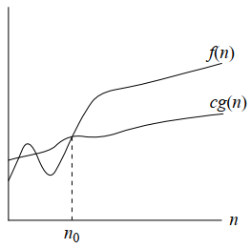
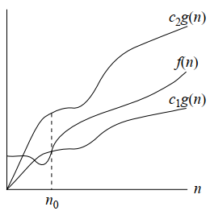
Intuition for Asymptotic Notation
big-Oh
f(n) is in O(g(n)) if f(n) is asymptotically less than or equal to g(n)
big-Omega
f(n) is in Ω(g(n)) if f(n) is asymptotically greater than or equal to g(n)
big-Theta
f(n) is in Θ(g(n)) if f(n) is asymptotically equal to g(n)
g(n) is an asymptotic upper bound for f(n).
g(n) is an asymptotic lower bound for f(n).
g(n) is an asymptotic tight bound for f(n).

